Slide 1
A Spatial Model of Home School Enrollment Trends with Missing and Censored Data Nick Grener 6990 Creative Component

Slide 2
Outline
Background
Data Procurement and Associated Challenges
Model Building
Results and Model Comparison
Final Discussion

Slide 3
Background
A recent article in The Washington Post described a widespread increase in home schooling over the last decade in America and furthermore indicated a 54% increase of home school enrollment in the state of Ohio (my home state) over the time frame from 2017–2022. The authors’ analysis was unable to identify any important drivers of this increase, instead concluding that, “Home schooling’s surging popularity crosses every measurable line of politics, geography and demographics.”
Notes:
I wanted to investigate this phenomenon at the level of local school districts. This project provided me with an opportunity to learn about several important concepts that I had not previously encountered in my coursework.

Slide 4
Data Sources
The Washington Post’s GitHub repository
Ohio Department of Education’s District Profile Report
State of Ohio’s Education and Workforce Report Portal
U.S. Census Bureau’s American Community Survey (ACS), accessed using the tigris package in R

Slide 5
Challenges in Data Procurement
Inconsistencies in the values of a key variable (school district information retrieval numbers) used to link data frames.
Change of support between the primary areal unit of interest in this study (school districts) and the areal unit of interest for two salient variables (county data)
Presence of missing and interval-censored home school enrollment data: of the 603 verified districts that could be matched from the ACS shapefile to the data from the Ohio Department of Ed, nearly 23 percent had home school counts that were either missing or censored for at least one of the years of interest

Slide 6
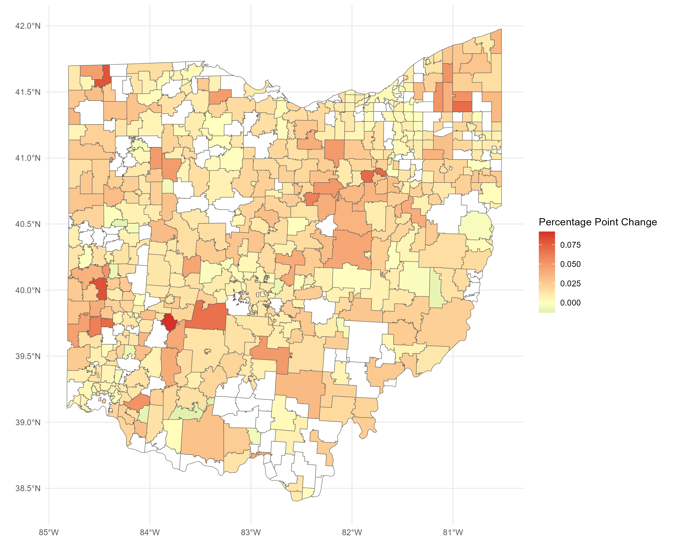
Difference in Annual Proportions of Home Schooled Students, 2017 vs. 2022.
Districts with missing or censored data are shown in white.

Slide 7

Model Building
Transformation of response variable allowed for a pseudo-Gaussian linear model framework for inference
From there, sequentially incorporate complexity:
Bayesian MCMC sampling techniques
Augmentation of missing and censored data
Inclusion of a spatial random effect

Slide 8
Model Building
Six candidate predictors representing potential social drivers of the change in homeschooling were selected for the model:
the percent of the enrolled students who identified as White,
the proportion of classroom teachers in the district with 10+ years of teaching experience,
the median income of the residents of the district,
the 4-year graduation rate for the high schools located within the district,
the county-level Republican vote share in the 2020 U.S. Presidential election,
pupil density (the full-time-equivalent count of K-12 students divided by the square mileage of the school district)

Slide 9

Model Building: MCMC sampler
A Markov Chain was set up with each step consisting of separate draws (each conditioned on the current values of the other parameter) from the two proposal distributions:
These proposal values derived from “alternating conditional sampling” (known as the Gibbs sampler) were then independently considered as possible draws from their respective full conditional posterior distributions. Each was accepted based on a probability determined by the likelihood ratio. The Markov chain was run until stationarity was suggested by trace plots of the parameters.

Slide 10
Model Building: MCMC sampler
Residuals suggested strong evidence of spatial dependence
need to incorporate the rest of the districts into the linear regression model using a process of stochastic data augmentation
need a spatial random effect to account for spatial autocorrelation and allow for improved inference of model parameters

Slide 11

Model Building: CAR model w/ spatial RE
The γ term denotes a zero-mean spatial random effect on the areal units governed by a covariance matrix parameterized by spatial dependence parameter ρ and random effect marginal variance parameter τ², while σ² accounts for measurement error.
Notes:
In the context of the present study, this γ term can be viewed as an attempt to account for one or more unmeasured spatially varying covariates that are relevant to the change in homeschool rates across Ohio.

Slide 12

Model Building: CAR model w/ spatial RE
For the CAR setting, the covariance matrix for the random effect will be defined in terms of a neighbor-weights matrix W via
I also considered a subclass of the CAR model which is known as an intrinsic conditional autoregressive (ICAR) model. In ICAR, the spatial dependence parameter is not estimated but is rather fixed in advance at ρ = 1, which requires the row-standardization of W and a sum-to-zero constraint on the spatial effect parameters.
Notes:
The appeal of the ICAR approach is identified by Ver Hoef et al. as such: despite the reduction in the number of parameters to estimate in the model (by fixing ρ), there still exists sufficient flexibility in the surface for fitting the data, and the sum-to-zero constraint keeps the spatial random error estimates under control and anchored near zero.

Slide 13


Model Building: MCMC in the CAR setting
IMPUTATION STEP
We can split out the conditional distribution of z into sub-vectors of the missing data and the rest of the observations yielding:
This implies that the distribution of the missing data conditioned on the rest can be written as a product of its conditionally independent marginal distributions:
Notes:
Therefore, at each step of the Markov Chain, imputing values for missing responses was achieved via sampling from a Normal distribution with the appropriate “most current” parameters

Slide 14

Model Building: MCMC in the CAR setting
IMPUTATION STEP
With respect to the censored data, the result is only slightly more complicated. Sampling for the censored data at each iteration amounts to sampling from a truncated multivariate normal distribution derived from:
In the context of this analysis, since single-digit values of the number of home schoolers were the censored values, the lower bound and upper bound for censored responses were derived by substituting the value 9 or 0 into the appropriate places.

Slide 15
Model Building: MCMC in the CAR setting
2. POSTERIOR STEP
With tentative imputed values for our censored and missing response values, samples were generated from f(θ|z) in the following manner:
• Direct posterior sample of β
• Probabilistic Gibbs sample of σ²
• Probabilistic block Metropolis sample of the spatial random effect parameters: τ²,ρ, and (conditioned on these first two) γ
Notes:
(A Gibbs sampler was discarded due to the demonstrably high correlation between the values of these 3 parameters)

Slide 16

Results: Model Comparison
Three model structures were selected for comparison: a linear (LIN) model with no spatial random effect, a conditional autoregressive (CAR) model, and an intrinsic conditional autoregressive (ICAR) model.
Hobbs and Hooten recommend using the posterior predictive loss function for model selection when comparing spatial hierarchical models, which uses a familiar format of a penalty term plus a goodness-of-fit term:
Notes:
For censored data, the goodness-of-fit term was recorded as zero for predictions that fell within the range of plausible response values and was calculated as the squared difference from the nearest endpoint of the range of plausible responses otherwise.

Slide 17
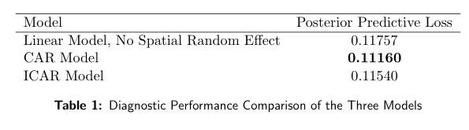
Results: Model Comparison

Slide 18
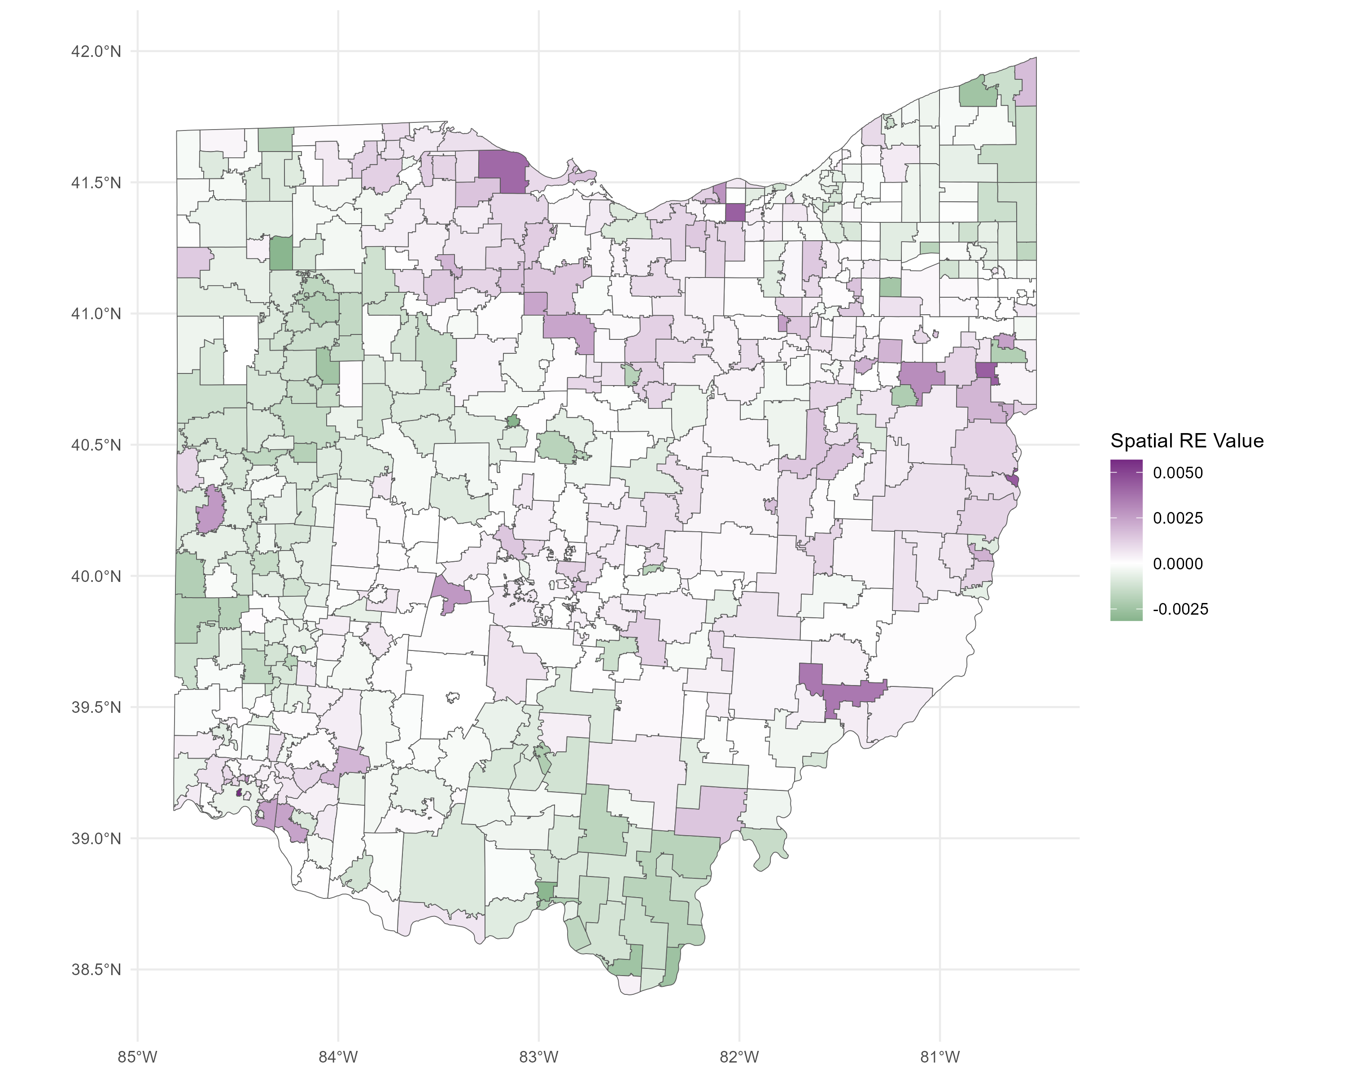
Results: Model Comparison
This map displays the posterior mean Spatial RE Surface for the CAR Model. The magnitude of these values is relatively small in comparison to the response values.
Notes:
A Moran’s I test for spatial dependence in the residuals was used to confirm that the CAR specification accurately captured most of the spatial dependency in the residuals from the original model.

Slide 19
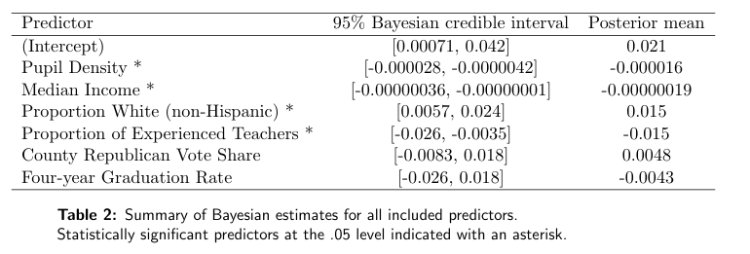
Results: Significant Predictors
The results from the CAR regression model show that four of the six predictors examined were found to have a significant association with an increase in home schooling in Ohio school districts between the years 2017 and 2022:

Slide 20
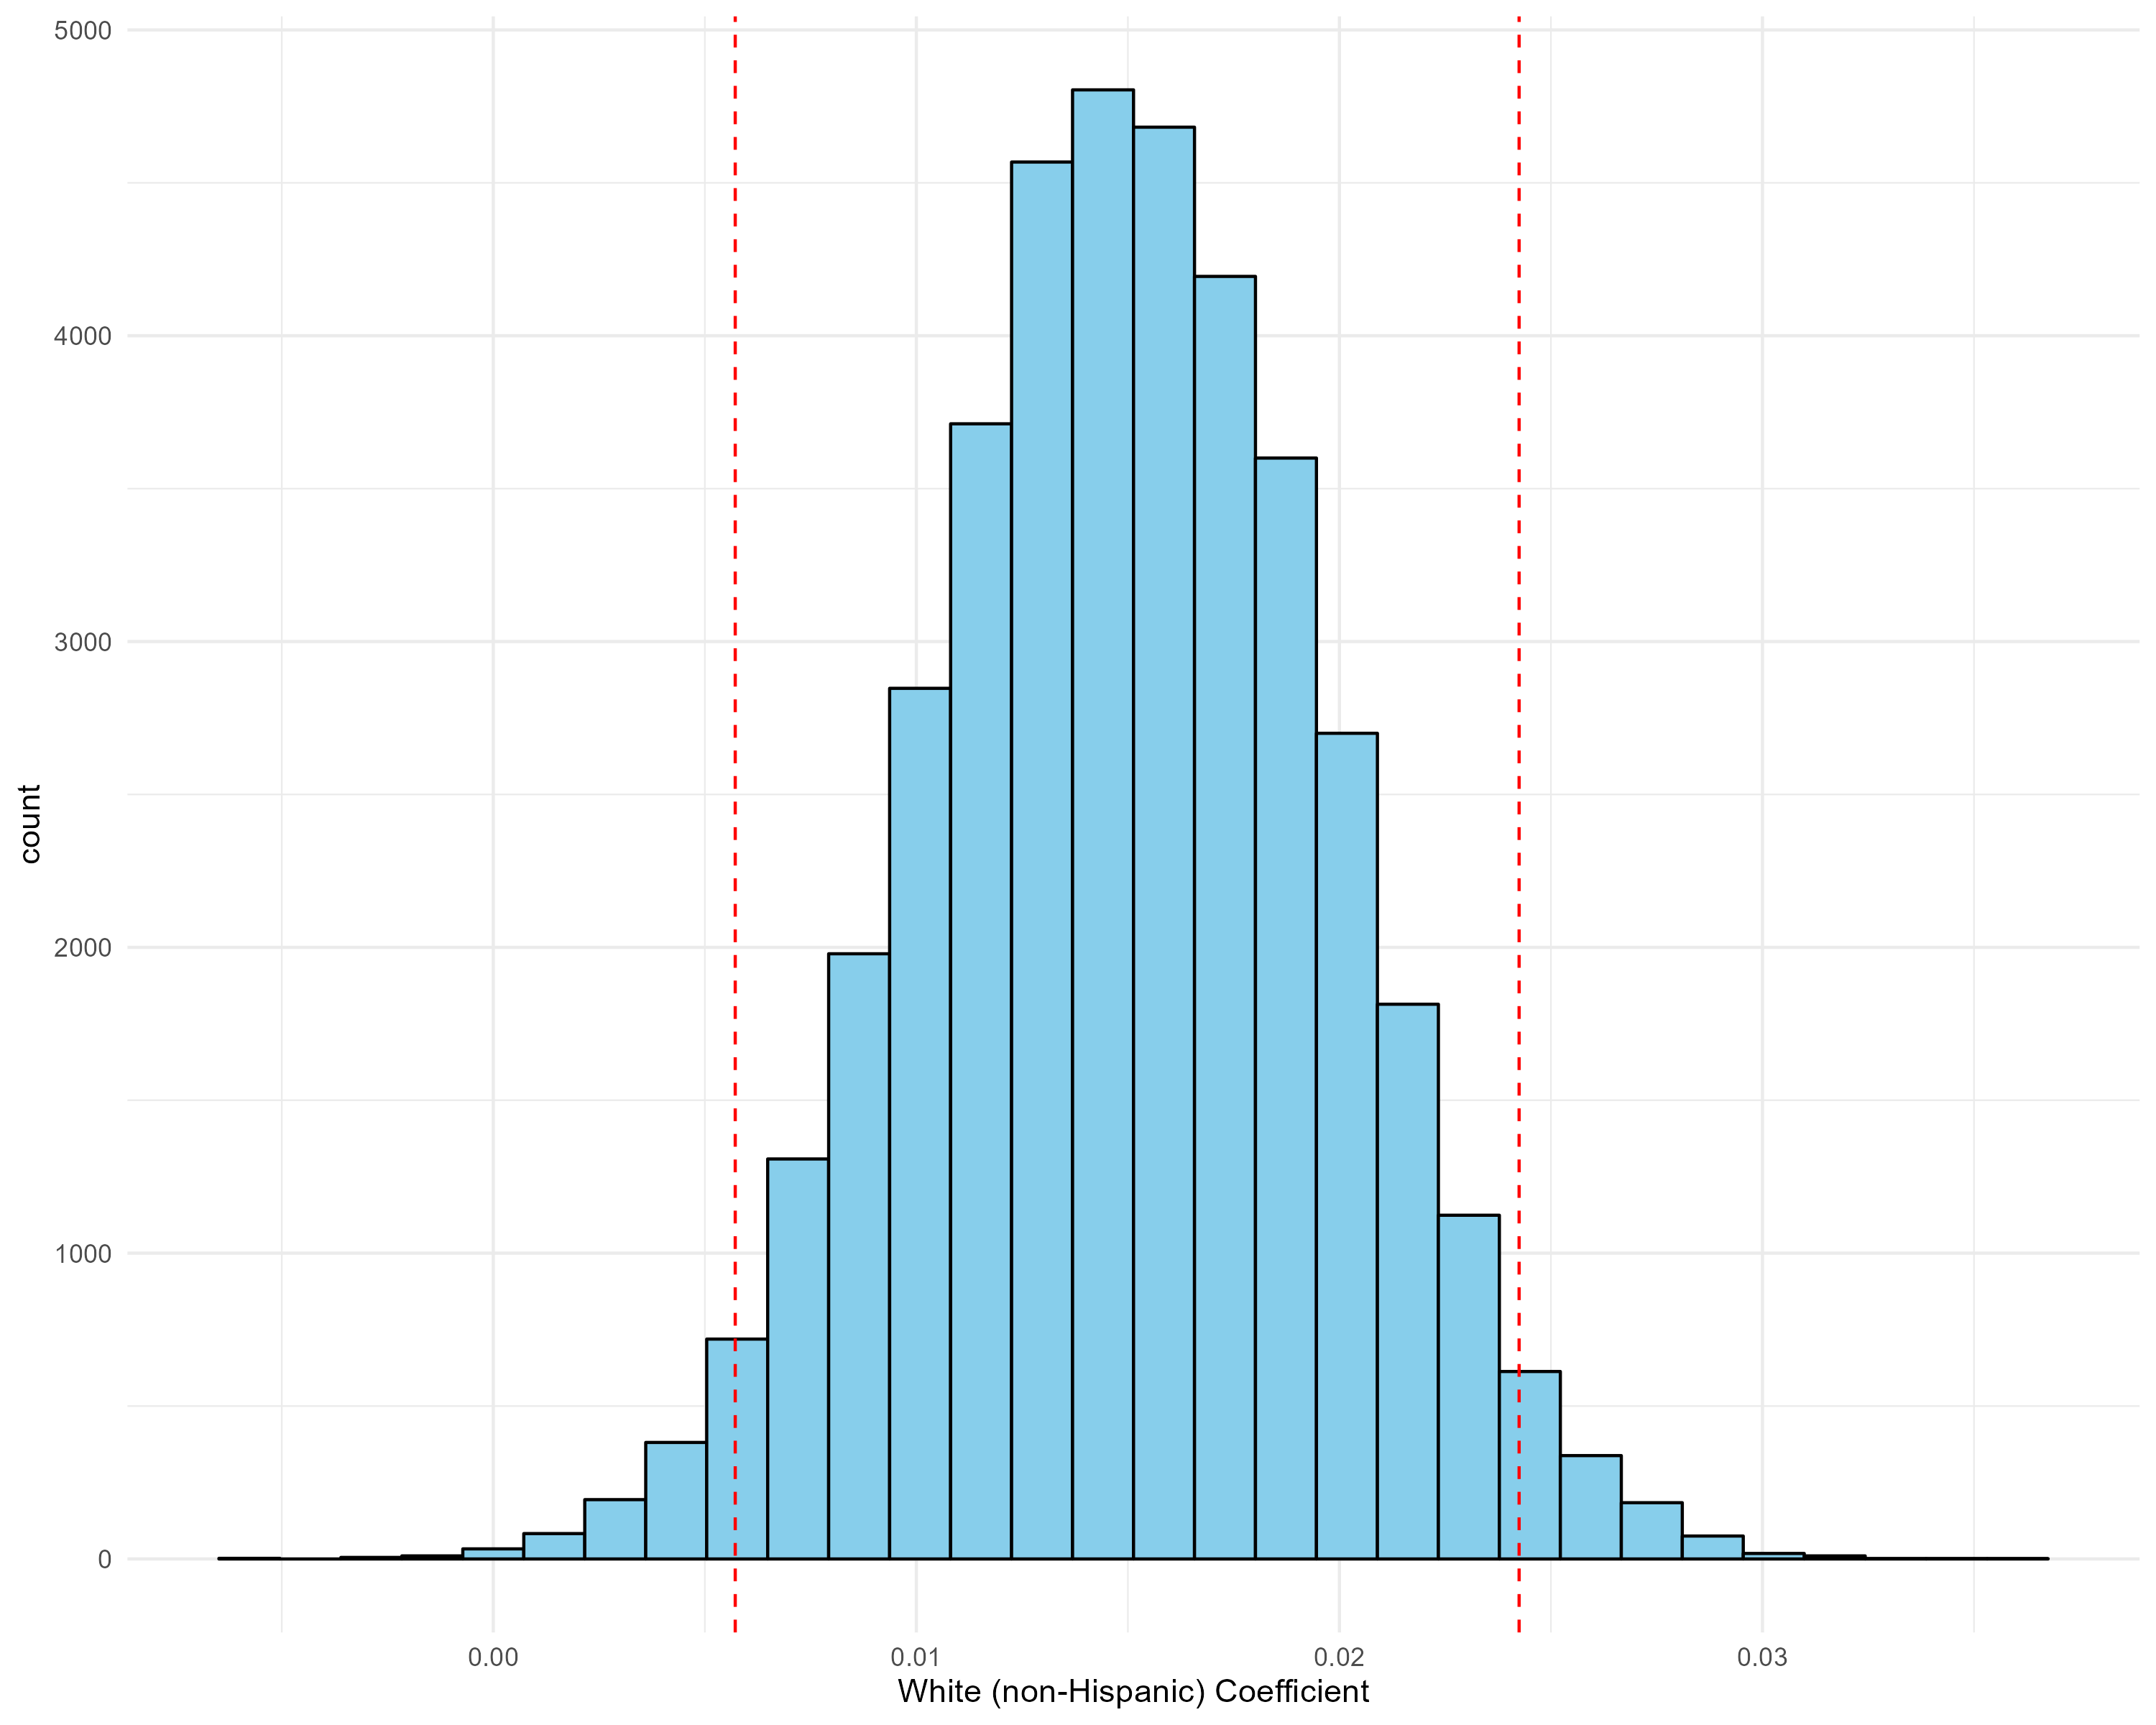
Results: Significant Predictors
Posterior distribution example - credible interval endpoints are indicated by the dashed lines.

Slide 21
Discussion
This analysis suggests that the surge in home schooling is greater among some factions of the population than others, at least in the case of Ohio. Of the demographic, economic, political, and educational factors examined here, it was discovered that school districts with more White residents, lower median income, lower population density, and a lower proportion of teachers with 10 or more years of experience were associated with a greater increase in home schooling than other districts, on average. Further research into this topic could try to ascertain if these patterns hold in other states and over more extensive time frames.

Slide 22
Thank you! Paper and references provided upon request: nick-grener@uiowa.edu

